Slide 1
Fast Alignment Heuristics
COMP462/561: Computational Biology Methods
*Based on Course Notes by Dr. Mathieu Blanchette

Slide 2
Smith-Waterman: Local Alignment (1981)
Problem:
Given two sequences, S and T, of lengths m and n, find the substring s of S and the substring t of T such that the alignment score of s against t is maximized
Algorithm: Dynamic programming algo (very similar to NW)
Initialization matrix
Fill matrix with appropriate alignment scores
Trace back from highest scoring cell(s) to find best alignment(s)

Slide 3
Motivation
Problem:
Given a query sequence, q, of length m (small, ~1000 nucleotides) and a large database (target), D, of size n (billions of nucleotides)
Find all local alignments of q within D that have a score above threshold, T
q
D
Notes:
Different w-mers lead to different hits.

Slide 4
Smith-Waterman?
SW is too slow…would take O(mn + m*hits)
How?
Trace back all entries of a dynamic programming matrix with a score>T
Too slow, too much memory!
n = 126,000,000,000
m = 1,000
Notes:
Give example of BLAST server: http://blast.ncbi.nlm.nih.gov/Blast.cgi?PROGRAM=blastn&PAGE_TYPE=BlastSearch&LINK_LOC=blasthome *remember to comment on how many people are using this server

Slide 5
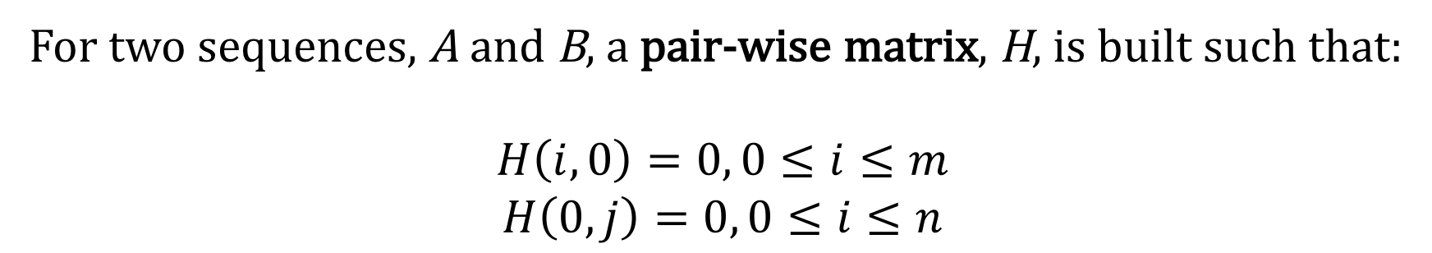
SW Initialization
For two sequences, A and B, a pair-wise matrix, H, is built such that:
$$H\left(i,0\right)=0, 0≤i≤m$$
$$H\left(0,j\right)=0, 0≤i≤n$$
A = CGTGAATTCAT
B = GCTTAC
 | - | C | G | T | G | A | A | T | T | C | A | T
- | 0 | 0 | 0 | 0 | 0 | 0 | 0 | 0 | 0 | 0 | 0 | 0
G | 0
C | 0
T | 0
T | 0
A | 0
C | 0
Notes:
NW would initiate with a linear gap penalty.

Slide 6
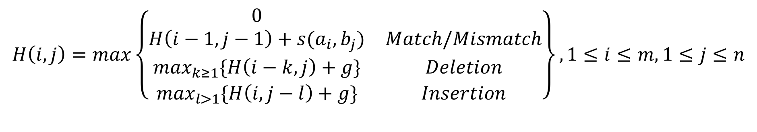
SW Matrix Filling
 | - | C | G | T | G | A | A | T | T | C | A | T
- | 0 | 0 | 0 | 0 | 0 | 0 | 0 | 0 | 0 | 0 | 0 | 0
G | 0 | ?? | ?? | ?? | ??
C | 0
T | 0
T | 0
A | 0
C | 0
 | - | C | G | T | G | A | A | T | T | C | A | T
- | 0 | 0 | 0 | 0 | 0 | 0 | 0 | 0 | 0 | 0 | 0 | 0
G | 0 | 0 | 2 | 1 | 2 | 1 | 0 | 0 | 0 | 0 | 0 | 0
C | 0 | 2 | 1 | 0 | 0 | 1 | 0 | 0 | 0 | 2 | 1 | 0
T | 0 | 1 | 0 | 3 | 2 | 1 | 0 | 2 | 1 | 1 | 1 | 3
T | 0 | 0 | 0 | 2 | 2 | 1 | 0 | 2 | 4 | 3 | 2 | 2
A | 0 | 0 | 0 | 1 | 1 | 4 | 3 | 2 | 3 | 3 | 5 | 4
C | 0 | 2 | 1 | 0 | 0 | 3 | 3 | 2 | 2 | 5 | 4 | 4
Similar to Needleman-Wunsch (NW), fill in the matrix such that:
With a match score of +2 and a mismatch & indel score equal to -1.
$$H\left(i,j\right)=max\left\{\left.\begin{matrix}0 & \\ H\left(i−1,j−1\right)+s(a_{i},b_{j}) & Match/Mismatch \\ \max_{k≥1}\{H\left(i−k,j\right)+g\} & Deletion \\ \max_{l>1}\{H\left(i,j−l\right)+g\} & Insertion\end{matrix}\right\}\right.,1≤i≤m,1≤j≤n$$
Notes:
Highlight the zero case in SW matrix filling.
0,2,1,2

Slide 7
SW Trace Back
With NW, we trace back from the bottom right-most cell of the matrix
Slightly different with SW. How?
Local Alignment #1 |  |  |  |  |  | Local Alignment #2
T | T | C | A |  |  | T | T | - | C
| | | |  | | |  |  | | | | |  | |
T | T | - | A |  |  | T | T | A | C
+2 | +2 | -1 | +2 |  |  | +2 | +2 | -1 | +2
 |  | =+5 |  |  |  |  |  | = +5
 | - | C | G | T | G | A | A | T | T | C | A | T
- | 0 | 0 | 0 | 0 | 0 | 0 | 0 | 0 | 0 | 0 | 0 | 0
G | 0 | 0 | 2 | 1 | 2 | 1 | 0 | 0 | 0 | 0 | 0 | 0
C | 0 | 2 | 1 | 0 | 0 | 1 | 0 | 0 | 0 | 2 | 1 | 0
T | 0 | 1 | 0 | 3 | 2 | 1 | 0 | 2 | 1 | 1 | 1 | 3
T | 0 | 0 | 0 | 2 | 2 | 1 | 0 | 2 | 4 | 3 | 2 | 2
A | 0 | 0 | 0 | 1 | 1 | 4 | 3 | 2 | 3 | 3 | 5 | 4
C | 0 | 2 | 1 | 0 | 0 | 3 | 3 | 2 | 2 | 5 | 4 | 4
 | - | C | G | T | G | A | A | T | T | C | A | T
- | 0 | 0 | 0 | 0 | 0 | 0 | 0 | 0 | 0 | 0 | 0 | 0
G | 0 | 0 | 2 | 1 | 2 | 1 | 0 | 0 | 0 | 0 | 0 | 0
C | 0 | 2 | 1 | 0 | 0 | 1 | 0 | 0 | 0 | 2 | 1 | 0
T | 0 | 1 | 0 | 3 | 2 | 1 | 0 | 2 | 1 | 1 | 1 | 3
T | 0 | 0 | 0 | 2 | 2 | 1 | 0 | 2 | 4 | 3 | 2 | 2
A | 0 | 0 | 0 | 1 | 1 | 4 | 3 | 2 | 3 | 3 | 5 | 4
C | 0 | 2 | 1 | 0 | 0 | 3 | 3 | 2 | 2 | 5 | 4 | 4
 | - | C | G | T | G | A | A | T | T | C | A | T
- | 0 | 0 | 0 | 0 | 0 | 0 | 0 | 0 | 0 | 0 | 0 | 0
G | 0 | 0 | 2 | 1 | 2 | 1 | 0 | 0 | 0 | 0 | 0 | 0
C | 0 | 2 | 1 | 0 | 0 | 1 | 0 | 0 | 0 | 2 | 1 | 0
T | 0 | 1 | 0 | 3 | 2 | 1 | 0 | 2 | 1 | 1 | 1 | 3
T | 0 | 0 | 0 | 2 | 2 | 1 | 0 | 2 | 4 | 3 | 2 | 2
A | 0 | 0 | 0 | 1 | 1 | 4 | 3 | 2 | 3 | 3 | 5 | 4
C | 0 | 2 | 1 | 0 | 0 | 3 | 3 | 2 | 2 | 5 | 4 | 4
Notes:
The largest value in the matrix may be in multiple cells. Potential for multiple optimum sub-sequences. http://phylo.cs.mcgill.ca/

Slide 8
Basic Local Alignment Search Tool Idea
Give up on (guaranteed) optimality
Heuristic approach
Search only for local-alignments with high-scoring gapless alignments (HSPs)
Pre-process the database, D, so that queries can be answered in constant time with respect to n
BLAST was published in 1990 by Altschul, Lipman, Miller,
cited by more than 10⁵ papers

Slide 9
Gapless Alignments
If q has a good alignment, X, somewhere in D
Then X is likely to contain a HSP
q
A C – T G A A T G A T C C A
D
A C T T G A A T G A T G C A

Slide 10
Preprocess Database to Build Indices
 | Index
0 | AAAA
1 | AAAC
 | .
 | .
 | .
4^{w}-1 | TTTT
D

Slide 11
Indexing the Database
 | Index
0 | AAAA
1 | AAAC
 | .
 | .
 | .
4^{w}-1 | TTTT
List of positions in the Database
Encoding: w-mer → 0, …, 4^{w}-1
*2-bit per character

Slide 12

Scanning for Hits in D
Given a query, q
For each w-mer in q
For each matches of q in D
Investigate match further…
O(|q|)
O(w)
How many hits do we expect for a w-mer of size 11?
$$\frac{3×{10}^{9}}{4^{11}} =1000$$

Slide 13
Improving Scan Times
Encode database indices in a trie
w-mer = TTA
q = TTAN
 |  |  |  |  | A |  | C | G |  | T
 |  | AA | AC |  | AG | AT |  |  |  | TA | TC | TG | TT
AAA | AAC | AAG |  | AAT |  |  |  | TAA | TAC | TAG | TAT |  | TTA | TTC | TTG | TTT

Slide 14
Extending hits to find High Scoring Pair (HSP)
Goal: Quickly determine if a match is promising or not
w
q
???
???
Seed
D

Slide 15
Ungapped Extension Phase
Total Score
Seed
D
Stop
left extension
HSP
Stop
right extension
Time?
Linear in size of extension

Slide 16
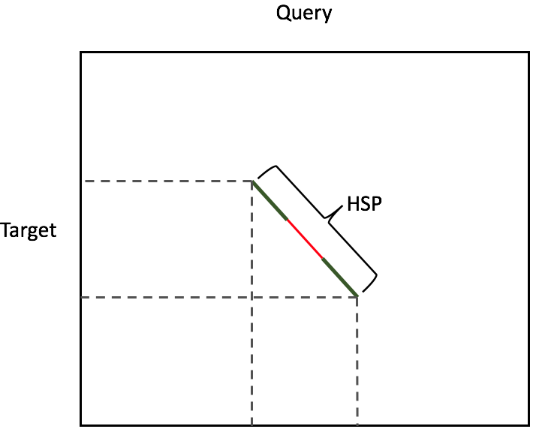
BLAST HSP
How can we improve the hit further?

Slide 17
Statistics of Local Alignments
Even if D was completely random, we would expect to observe some pretty high scoring HSPs
How do we know when we should get excited?
E-value (score(HSP))
The expected number of local alignments with a score greater or equal to HSP’s that would be found in a random D

Slide 18
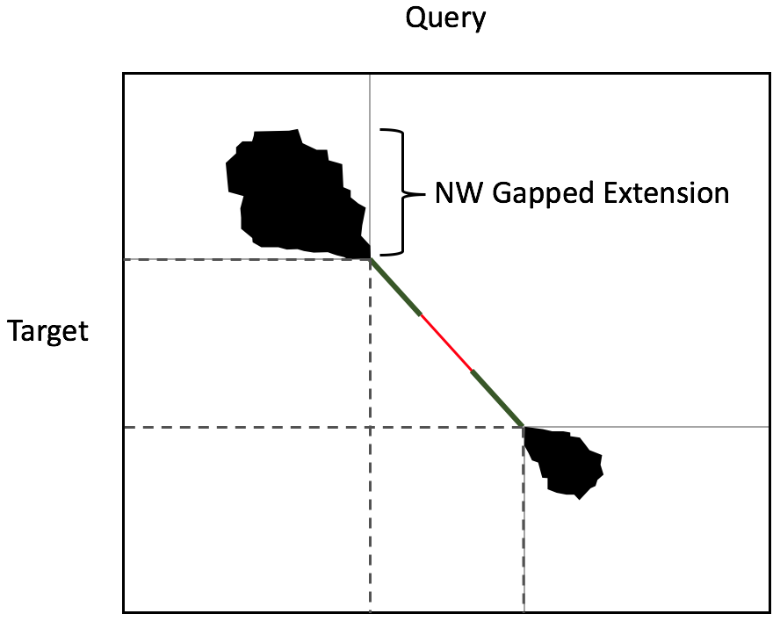
Gapped Extension
If the HSP’s alignment score is greater than some threshold, T
Do a more expensive gapped extension
Using a variant NW
Perform NW in each direction
Consider only entries with score greater than “best so far”

Slide 19
Choosing the size of w
Small (<=11)
High probability of finding exact w-mer in HSP
Lots of false positive seeds
High sensitivity
Slow
Large (>12)
Miss many HSPs
Few false positives
Low sensitivity
Fast

Slide 20
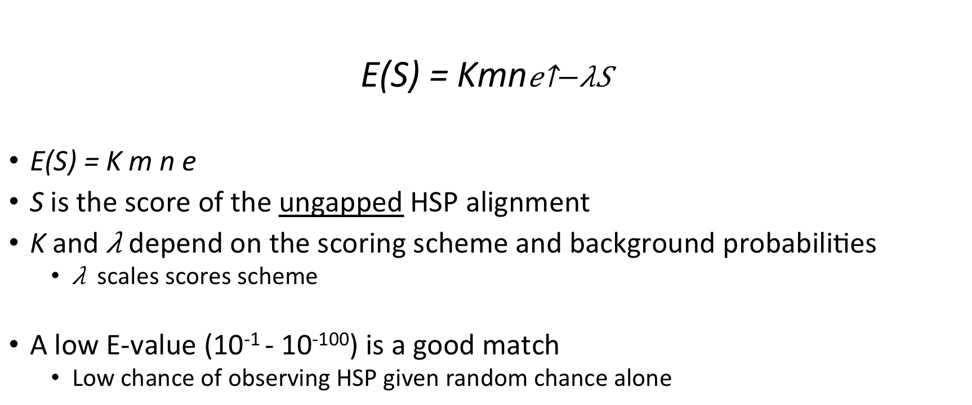
Karlin-Altschul (1990)
E(S) = Kmn
E(S) = K m n e
S is the score of the ungapped HSP alignment
K and depend on the scoring scheme and background probabilities
scales scores scheme
A low E-value (10⁻¹ - 10⁻¹⁰⁰) is a good match
Low chance of observing HSP given random chance alone

Slide 21
Variants
For proteins: inexact matches are considered
Based on a point accepted matrix (PAM)
Query | Target | BLAST variant
DNA | DNA | blastn
Protein | Protein | blastp
Protein | DNA | tblastn
DNA | protein | blastx

Slide 22
Optimizations
Dealing with repeats in q or D
Two-Hit method
Gapped seeds
Lower T to allow more hits, but only extend if two hits fall on the same diagonal
Within a window of fixed length
Increases hits and lowers extensions

Slide 23
Upcoming Topics
Wednesday – multiple sequence alignment (MSA)
Dr. Blanchette will return!
End of the semester – Burrows-Wheeler Transform (BWT)
https://en.wikipedia.org/wiki/Burrows%E2%80%93Wheeler_transform
In pattern matching: https://www.youtube.com/watch?v=z5EDLODQPtg

